Slide 1
More on
Ms Access
Management Information Systems
Disha Parkhi

Slide 2
Outline
More on Ms Access: forms, queries and reports
File: students.accdb
Reading:
Chapter 2

Slide 3
Databases objects
.accdb file
Table3
Query2
Table1
Query1
Table2
Report
Form1
Form2

Slide 4
Forms, Reports, and Queries
Open students.accdb

Slide 5
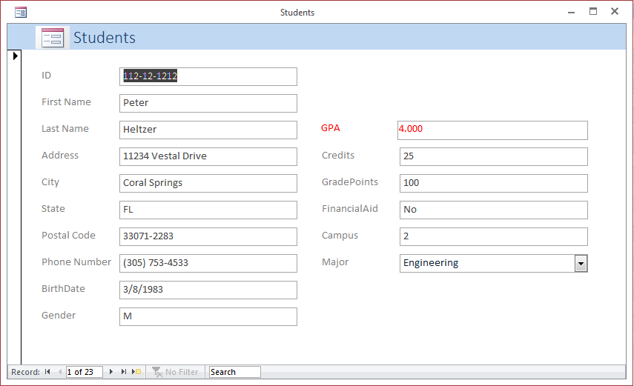
Forms
Easy and aesthetic way to interact with the database
  View, change or insert new data

Slide 6
What are reports?
Designed for non-interactive access to the data
  Printing or simply viewing
Data organization
  Sorting or grouping

Slide 7
Reports
Suppose we want to print a list of students the following way:
It should show the first name, last name, gender, and phone number, in that order
Group the students by major
Students sorted within each major by last name, and then by first name (if same last name)
At the end of each group, a count of the number of students in the major.

Slide 8
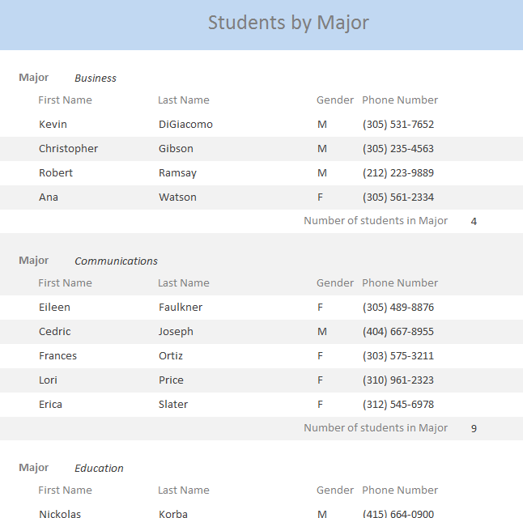
Reports

Slide 9
What are queries?
Queries extract data from the database according to some criteria defined by the user.
Queries tables look and function like regular regular Access tables, so they can be used for other queries, or to create reports or forms…
Queries do not duplicate the data – think of queries as a set of instructions that determine which data to get from the database. Every time you open a query, the instructions are run, and the corresponding data is displayed. But when you close the query, the displayed data is gone; all that is saved in memory are the instructions. As a consequence, we have the next property:
A query always shows the most updated data

Slide 10
Queries
Students sorted by GPA: I want to sort the students by GPA, and see their name, major, financial aid information, number of credits and GPA.
Students in Business from FL: Who are the students majoring in Business that are from Florida?
School awards winners: The school awards a prize to the students with GPA at least 3.5. Who are the winners?

Slide 11
Back to why we did not have a field for the GPA on the table…
Since the GPA results from a calculation using the GradePoints and TotalCredits, when we need the GPA, we can create a query that instructs the GPA to be calculated.
A database is all about storing information efficiently. Why wasting space to store the GPA on the table Students and risking inconsistencies between the field GPA and fields GradePoints and TotalCredits, when we can use a query to get the GPA?

Slide 12
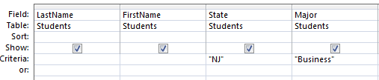
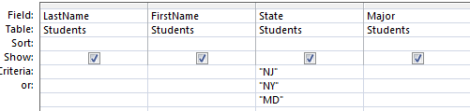
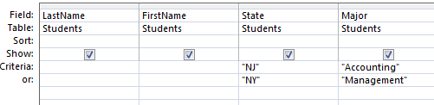
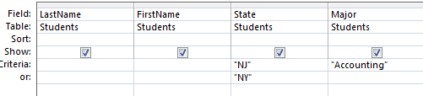
Queries: ‘AND’ and ‘OR’ operations
Students from NJ and majoring in Business
Students from NJ or NY or MD
Students from NJ and majoring in Accounting or students from NY majoring in Management
Students from NJ and majoring in Accounting or students from NY

Slide 13
Queries criteria: Wildcards and ‘Like’
Wildcard | Explanation
* | Allows you to match any string of any length (including zero length)
? | Allows you to match on a single character
# | Allows you to match on a single numeric digit
Like 'b*' - all values that start with b
Like '*b*' - all values that contain b
Like '*b' - all values that end with b
Like 'b?' - all values that start with b and are 2 characters in length
Like 'b???' - all values that start with b and are 4 characters in length
Like 'b#' - all values that start with b and are 2 characters in length where the second character is a number

